Slide 1

Code Refactoring and Bug Fixing

Slide 2


About me
Intoduction
Pranavkumar Patlolla i completed my Master in Statistics.
Why you want to learn Data Science
Manipulating and analyzing large datasets, building predictive models, and deriving actionable insights require critical thinking, problem-solving skills, and a deep understanding of statistics and programming. For intellectually curious individuals, data science presents a stimulating challenge.
Linkedin: www.linkedin.com/in/patlolla-pranav-kumar
Github: https://github.com/PranavKumarPatlolla/Bug-fixing-project

Slide 3
Scenario:
A team of enthusiastic data scientists embarked on a mission to develop a Note Taking Application using Python, Flask, and HTML. However, their lack of experience in backend development has led to challenges in making the application fully functional. Recognizing your proficiency in backend development, you have been tasked with fixing the broken code and ensuring the application works seamlessly.
Task:
Refactor the existing codebase and ensure the proper functioning of the Note Taking Application. Document all identified bugs during the debugging process. Remember, the task is not about recreating the app from scratch. Your goal is to fix the already existing codebase and make the application work as intended.
More Details:
The application's home route contains a text field and a button. Users can add a note, and all the notes should be displayed as an unordered list below the text field on the same page.

Slide 4
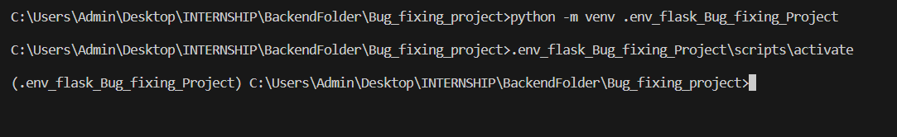
On Visual Studio to fix bugs by using Python and Flask frame work.
Mandatory steps:
Create a Virtual envirnoment in app folder by using this code.
Activate the virtual envirnoment by using this below code.
Run python app.py file to check how was web interface.

Slide 5
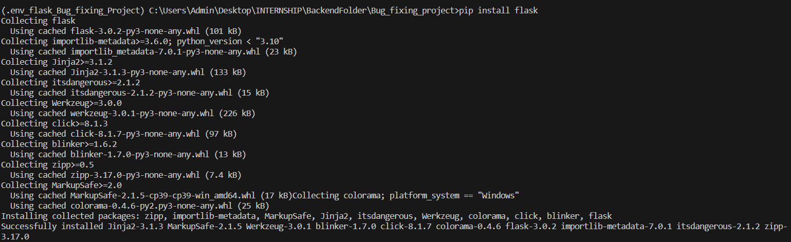
Install flask in Virtual environment

Slide 6
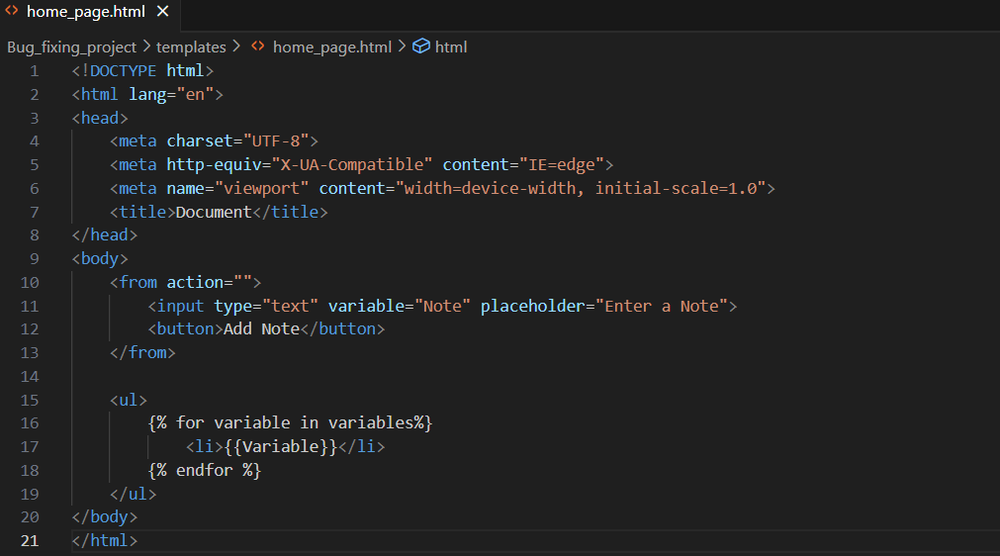
Before Fixing Bugs

Slide 7
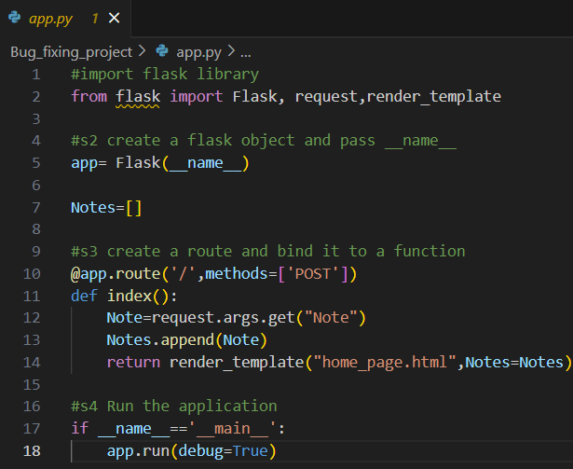

Slide 8
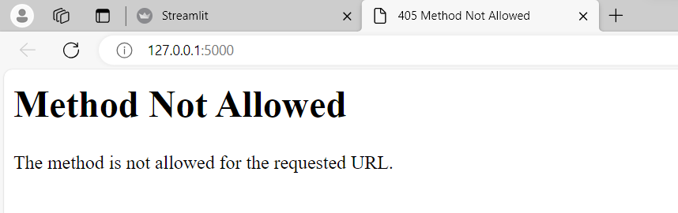
↓
In Http Response status code 405 means Method not allowed

Slide 9
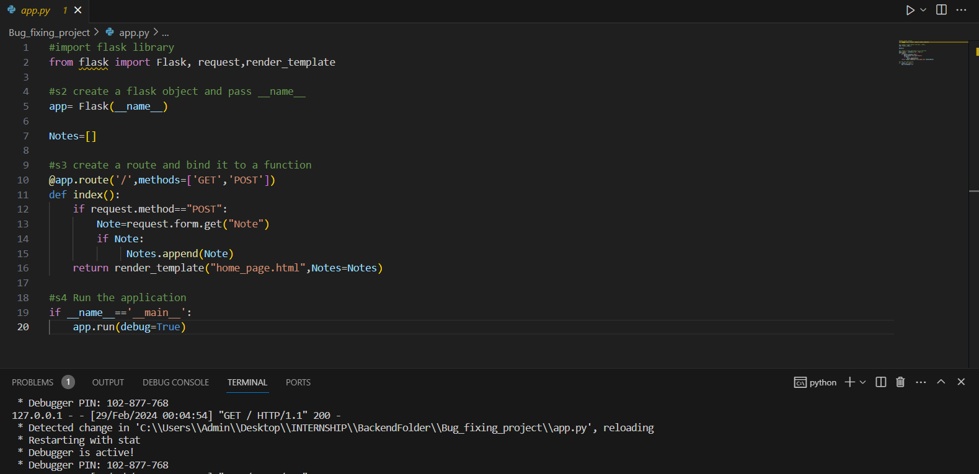
After Fixing The Bug

Slide 10
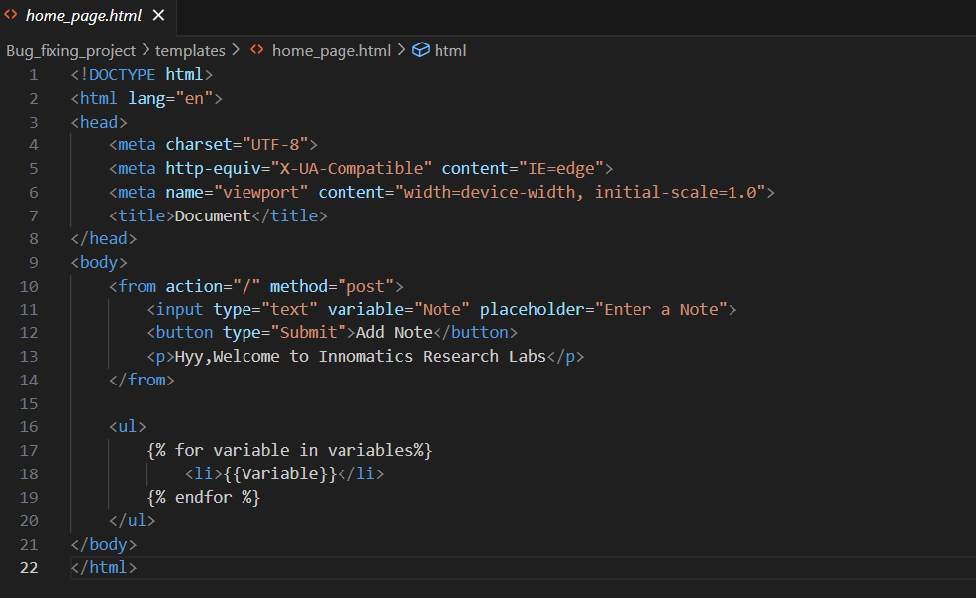

Slide 11
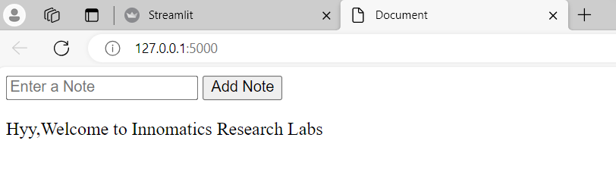

Slide 12

THANK YOU

